Slide 1

CUI Abbottabad
Department of Computer Science
SRE
12
Functional Requirements

Slide 2
Outline
DFD Diagram
https://www.lucidchart.com/pages/data-flow-diagram

Slide 3
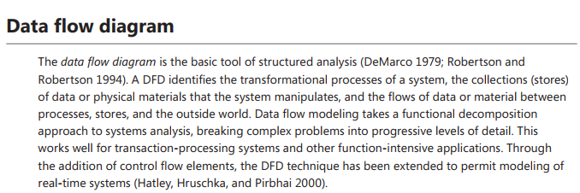

Slide 4
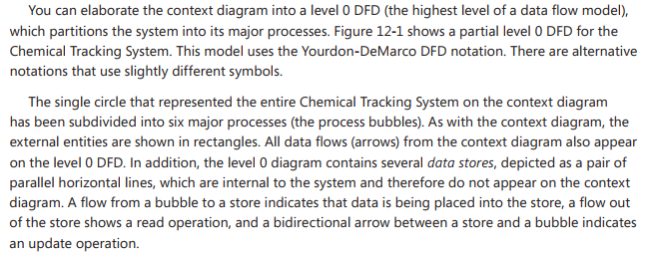

Slide 5



Slide 6
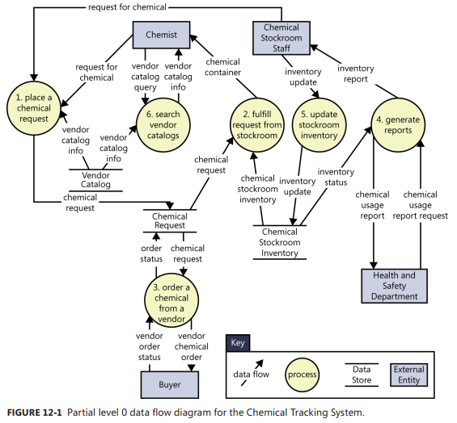

Slide 7
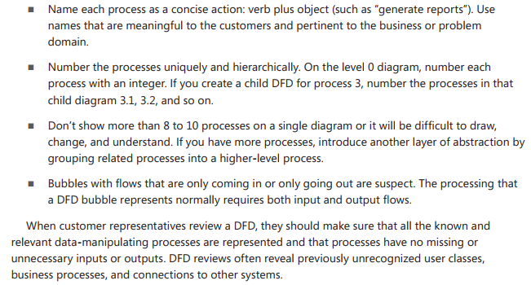

Slide 8
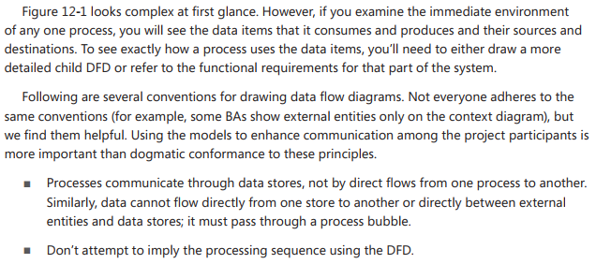

Slide 9
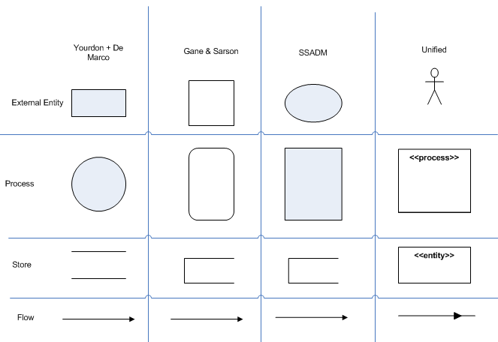

Slide 10
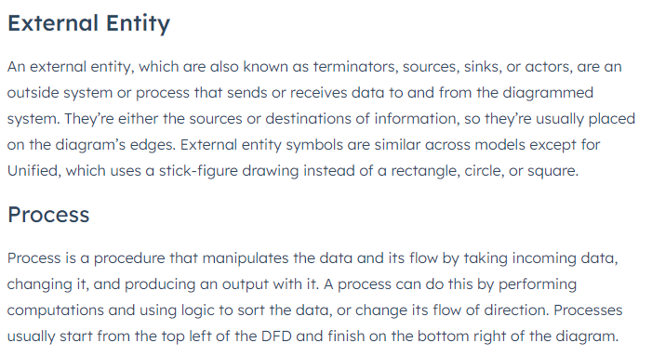

Slide 11
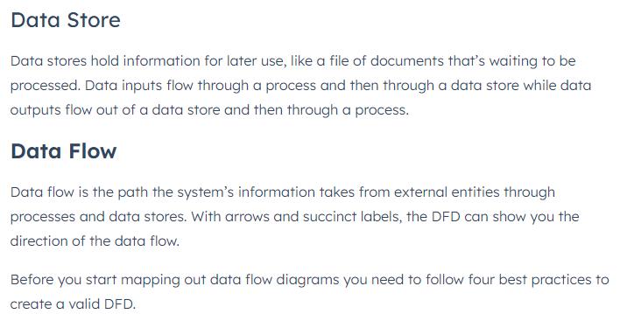

Slide 12


Slide 13
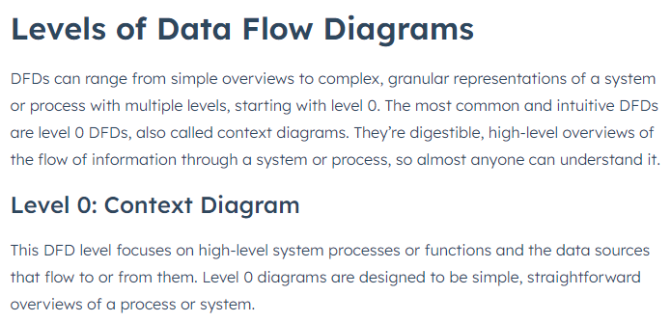

Slide 14
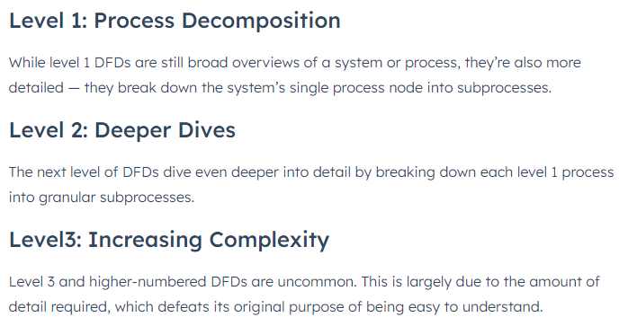

Slide 15


Slide 16
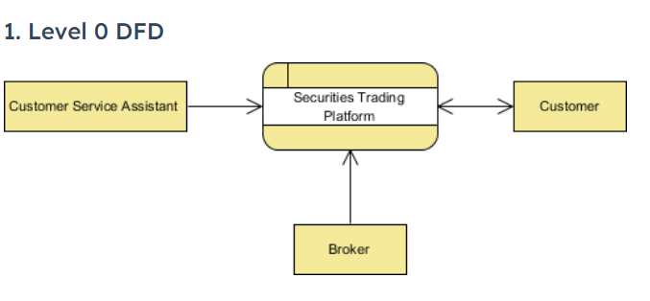


Slide 17



Slide 18
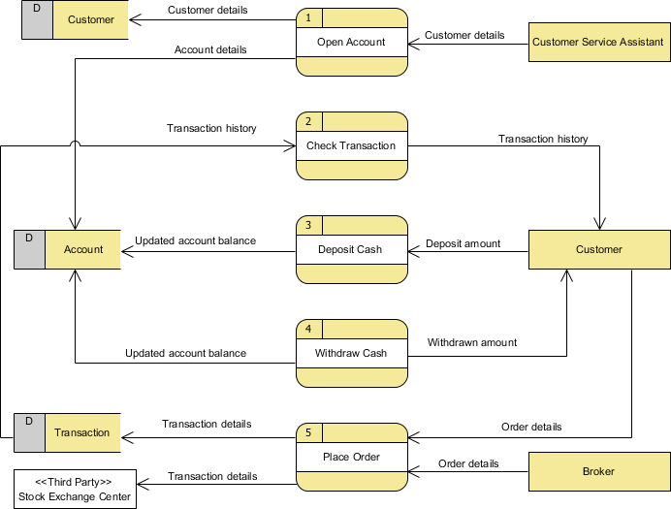

Slide 19
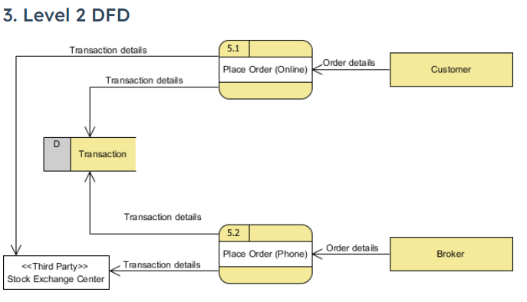

Slide 20


Slide 21
